Slide 1


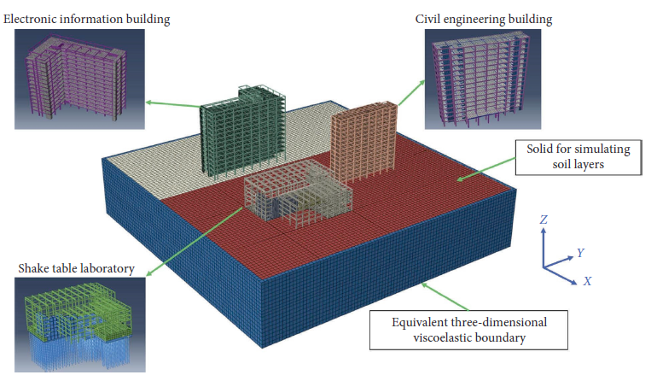
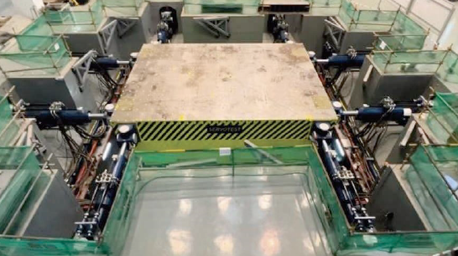


PROJECT
IMPLEMENTATION:
Using Deep Learning to Estimate Vibration Comfort of Large-Scale Shake Table During Operation
Structural Health Monitoring & AI
Presented By :
Date :
Sulagna Basack
26th March, 2026

Slide 2
DUMMY DATA SET GENERATION:
Presented by: Sulagna Basack
ID: 24EC10025
Raw data set was generated which contains 500 records of ground motion records in the format used in NGA-West2 Database.
RSN (Record Sequence Number): Unique ID, Primary key.
Magnitude: Characterise the seismic source (logarithmic measure of total seismic energy released by the earthquake)
Vs30(m/s): Time-averaged shear-wave velocity in the top 30 m of soil.
Epicentral_Distance (km): Horizontal distance from the earthquake epicentre to the recording station.
Depth(km): Depth of the earthquake under epicenter.
Duration_original(s): Duration of raw ground-motion file BEFORE any standardisation.
Sampling_Freq (Hz):Original sampling frequency of the accelerogram.
Notes:
Higher Magnitude → longer shaking duration and richer low-frequency content.
This feature is used in the regression model (log-domain correlation with WAL).
Soft soils amplify long-period energy. Controls frequency-dependent amplification of the signal before it arrives at the shake table foundation. Used as log(Vs30) feature in regression.
Used as log(distance+1) feature to capture attenuation effects on PGA.
Shallow events (<20 km) produce more impulsive, high-frequency records; deep events have longer travel paths. Affects the frequency content and duration of the record. Not a direct regression feature.
Records shorter than 60 s will be zero-padded; longer records are cropped around the PGA peak to a 60 s window as per pre-processing methodology of paper. The paper requires all inputs to the 1D-CNN to be exactly 3 000 time steps (60 s × 50 Hz). This column tells how much padding or cropping is needed.

Slide 3
DUMMY DATA SET GENERATION:
Presented by: Sulagna Basack
ID: 24EC10025
PGA_X (g) - Peak Ground Acceleration in the X (longitudinal) direction, in units of g (1 g ≈ 9.807 m/s²).
PGA_Y: Secondary regression feature (=0.85 × the X-channel peak)
PGA_Z: Tertiary regression feature (= 0.65 × X-peak )
Dominant_Freq_X (Hz) - Dominant (peak spectral) frequency of the X-direction accelerogram. (Resonance if matches natural freq)
Dominant_Freq_Y: Cross-directional resonance can increase torsional strains.
Dominant_Freq_Z: Relevant for vertical vibration comfort Estimation.
Notes:
This is the raw, un-normalised scalar value of the strongest acceleration in the horizontal X channel. Primary regression feature. PGA_X directly controls the energy input to the structure and is the strongest predictor of WAL at all 9 measuring points.

Slide 4
Presented by: Sulagna Basack
ID: 24EC10025
PRE-PROCESSING METHODOLOGY:
Raw Acceleration Signals for each of the ground motions are created synthetically to get a long time series data of ground motions.
Simplified Synthetic waveform: decayed sinusoid + noise
Creates a slowly-decaying amplitude envelope.
A real earthquake accelerogram has three physical phases: silence → build-up → strong motion → decay. The envelope simulates this shape.
Pre-Processing Steps:-
1. Normalisation and Scaling of Data
2. Resampling at 50Hz
3. Duration Standardisation acc to given convention
4. WAL Calculation

Slide 5
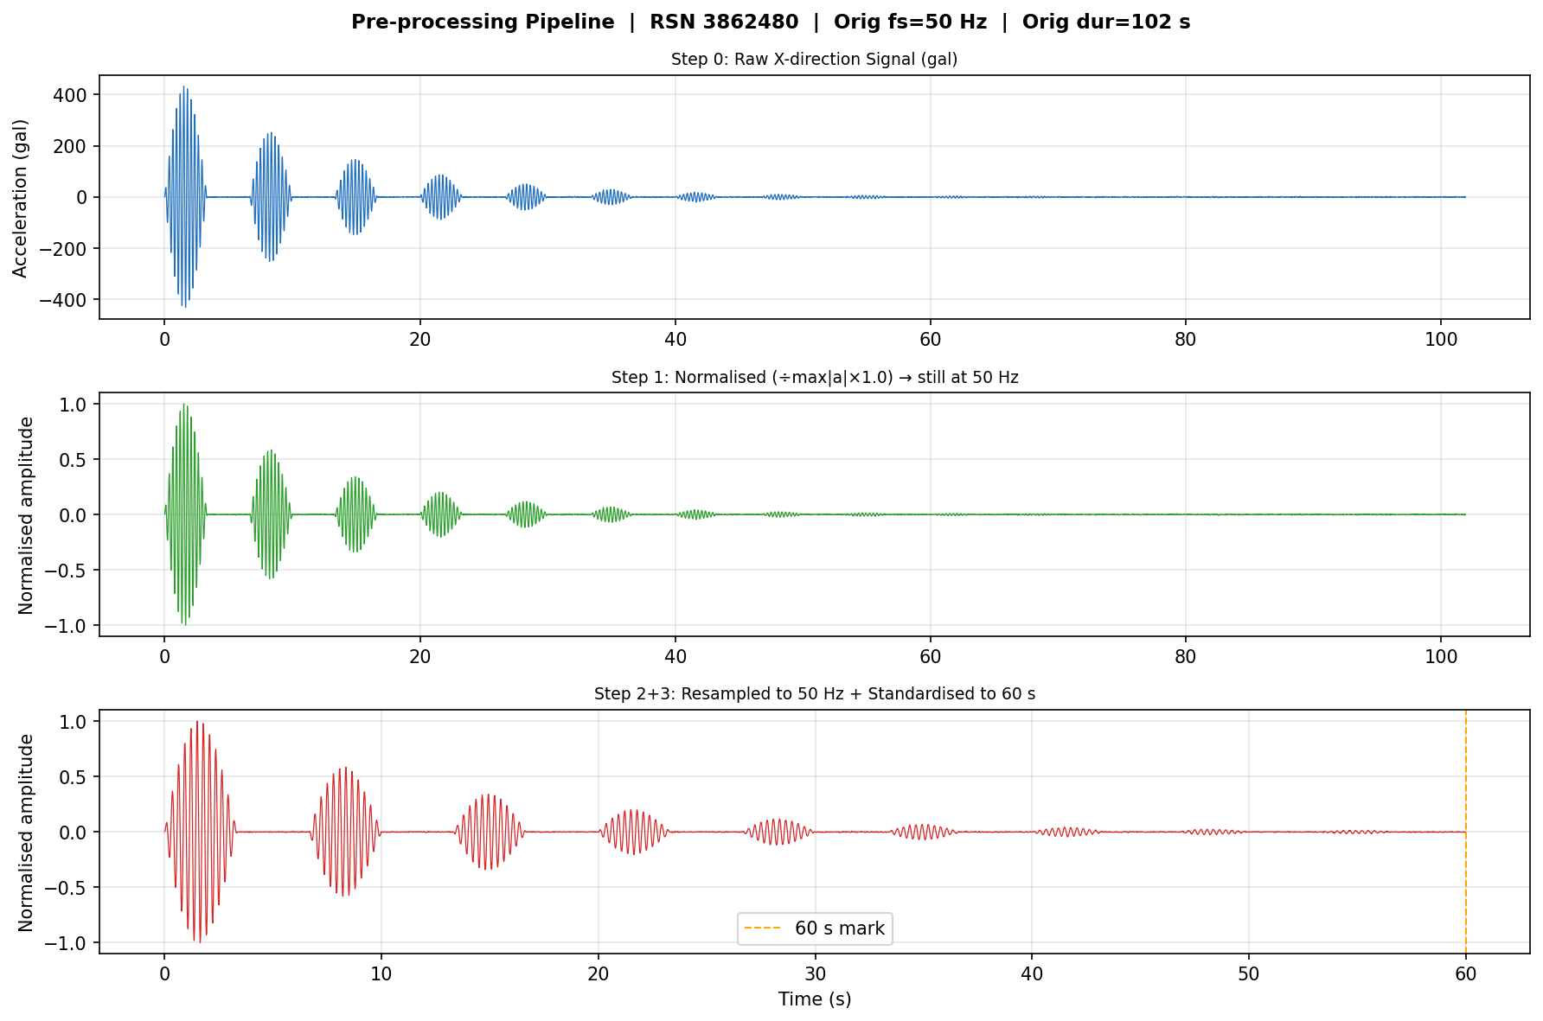

Slide 6
FEATURE CODING:
Presented by: Sulagna Basack
ID: 24EC10025
Features: Individual measurable properties or characteristics (input variables).
Features:-
RSN
Normalised PGA in 3 directions (worst instant of ground accelaration)
RMS of time series generated in 3 directions
Arias_X (total accumulated energy of time series data)
Magnitude of earthquake
log(distance from epiventer)
log(depth of earthquake)
log(peak velocity of 30m topsoil)
Our feature matrix contains 11 features, 1 RSN, 9 WAL values at different measuring points
Notes:
During dataset generation, the ay and az were generated as a random ratio of ax and hence are linearly depenedent on it.
So for linear regression, these features are not included in the feature list as it makes the linear regression split the effect of WAL change on x,y,z values when only x is the independent reading.
Removing these two features makes our featutre list smaller and more efficient but the MAPE remains same. This is however not the case for real earthquake signals in which all three are indepndent

Slide 7
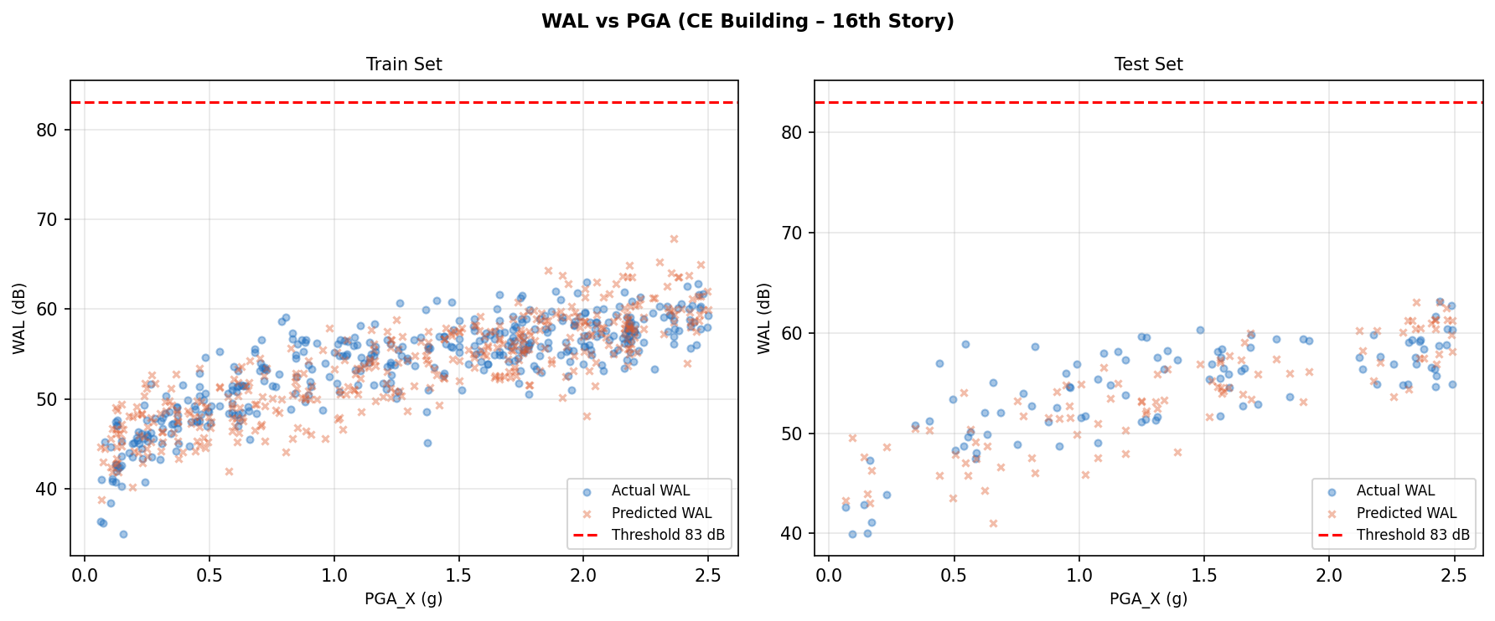
Notes:
During dataset generation, the ay and az were generated as a random ratio of ax and hence are linearly depenedent on it.
So for linear regression, these features are not included in the feature list as it makes the linear regression split the effect of WAL change on x,y,z values when only x is the independent reading.
Removing these two features makes our featutre list smaller and more efficient but the MAPE remains same. This is however not the case for real earthquake signals in which all three are indepndent

Slide 8
Presented by: Sulagna Basack
ID: 24EC10025
MODEL TRAINING AND TESTING:
The 500 record synthetic data is split 80:20 ratio for training and testing respectively.
Our model is a linear regression model that fits a straight line to the training data and then test the linear regression model with the testing data.
Our number of iterations is restricted to 1000 steps and learning rate is 0.01.
Predict current Y = X.weight + bias (this is in the form of matrix equations thus dot product is used)
Calculate gradients of weights and bias (derivatives) normalised by number of samples
Use gradient descent to reach local minima.

Slide 9
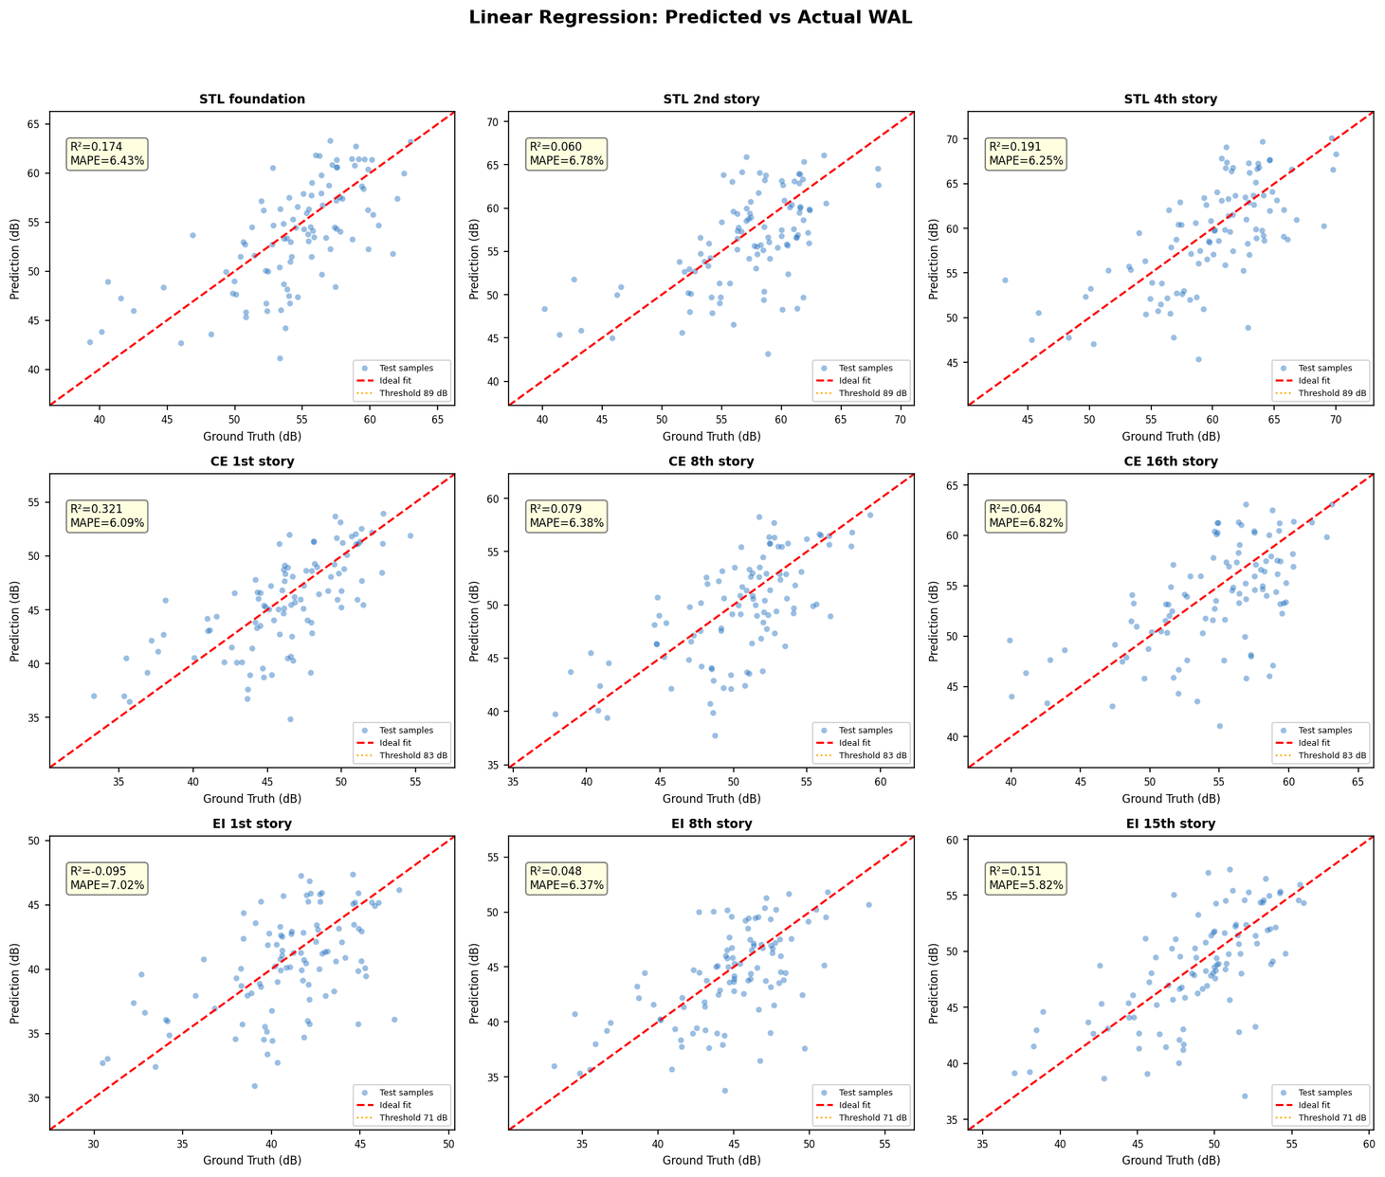

Slide 10
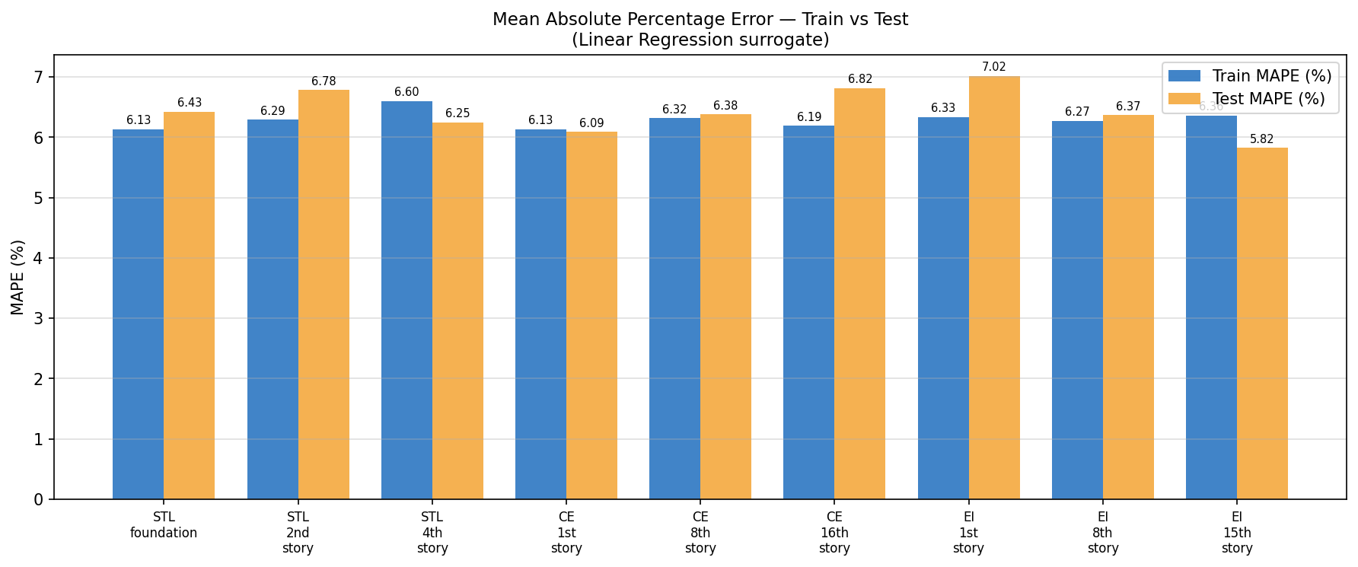
Presented by: Sulagna Basack
ID: 24EC10025
MODEL VERIFICATION:
MAPE (Mean Absolute Percentage Error) and R2 score (1-(SS_res/SS_tot)) are used to compare the predicted values to the actual values of WAL for the 9 measuring locations.

Slide 11
THANK
YOU

